Slide 1
Voorbeeld project

Slide 2
Agenda
Introduction
Role
Solution
Improvements & challenges

Slide 3
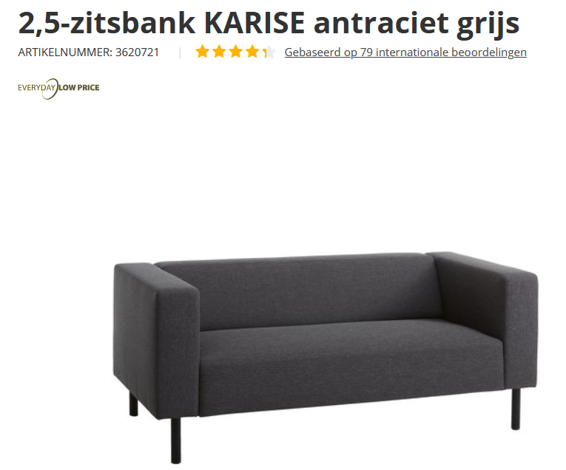
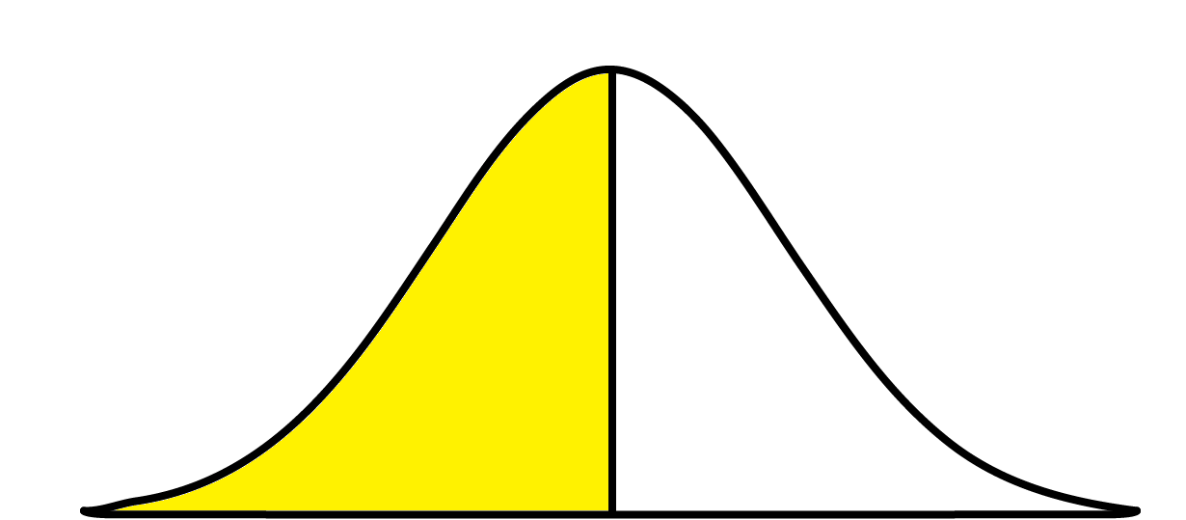


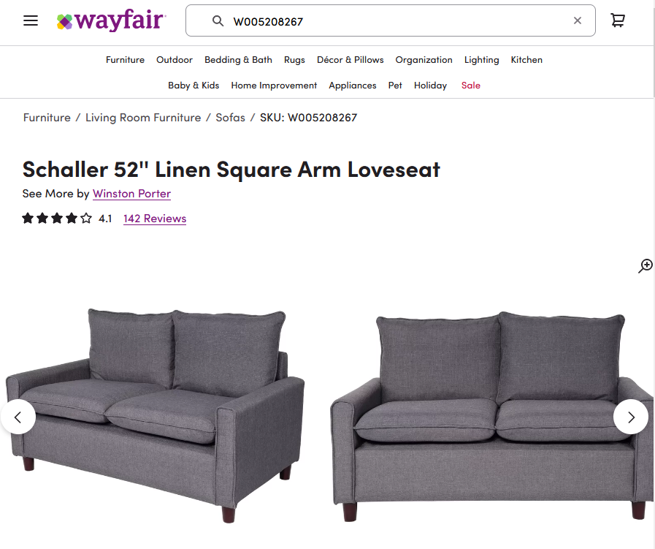
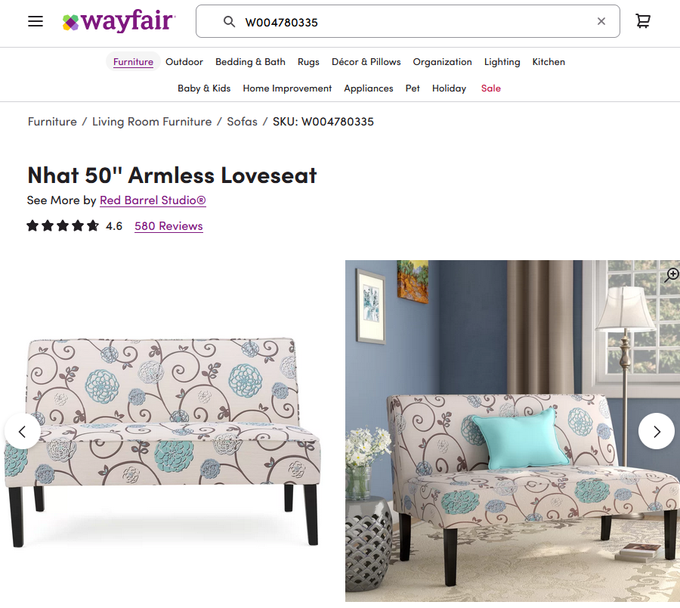
IKEA: product matching
IKEA
MATCH
NO MATCH

Slide 4
Joint cross-functional team
15 people (Valcon & IKEA)
2 data scientists (later 3)
Responsibilities:
  Initial version
  Iterative modelling improvements

Slide 5
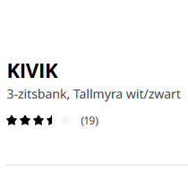
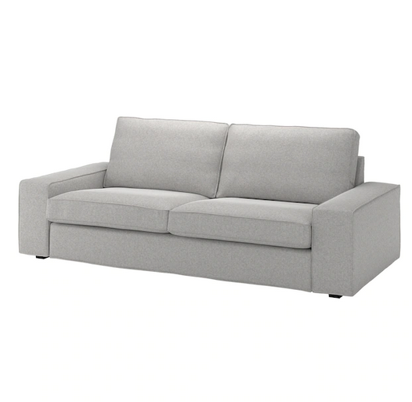
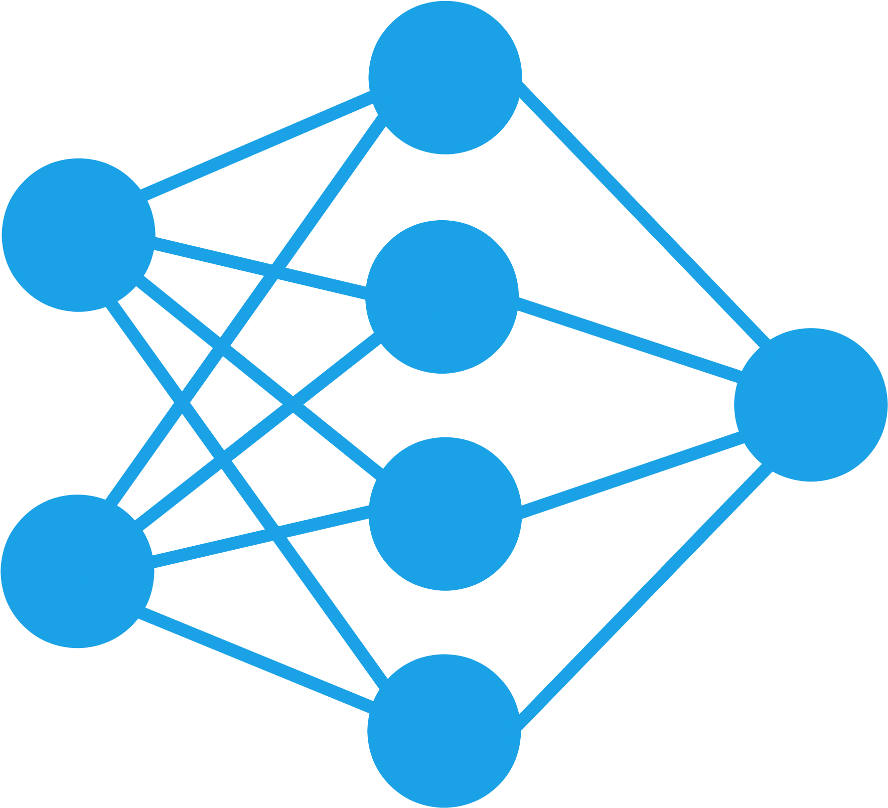
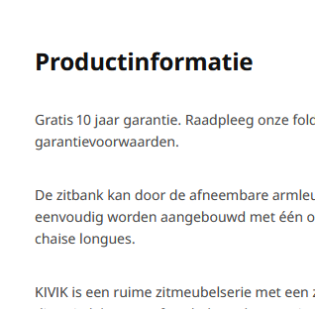
Solution (1)
Product information → embeddings
title
Machine learning models
embeddings | vector | vector
0 | … | 0
0 | … | 1
1 | … | 0
… | … | …
1 | … | 0
0 | … | 0
0 | … | 1
images
description

Slide 6
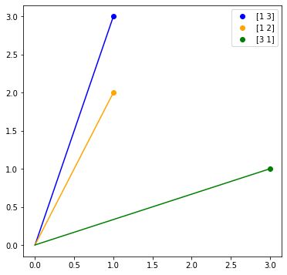
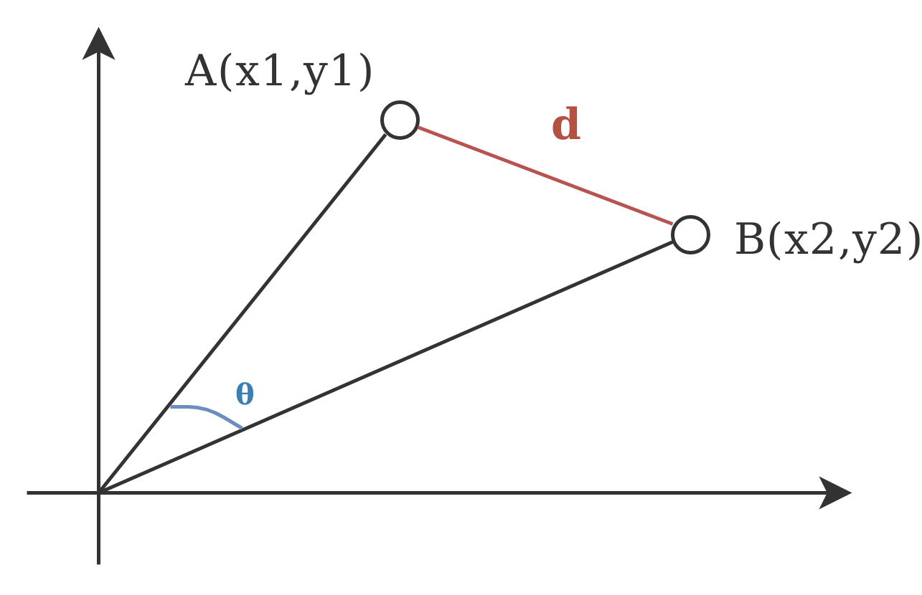

Solution (2)
Embeddings → scores
Blue compared with … | Cosine similarity
Orange | 0.99
Green | 0.60

Slide 7
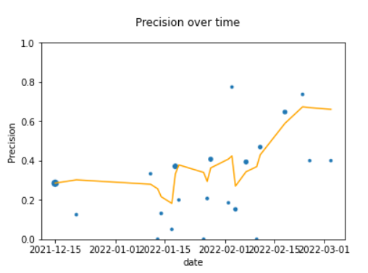
Solution (3)
Scores → ranking
Supervised classification model
  Features: scores
  Target: validated (non-)matches

Slide 8
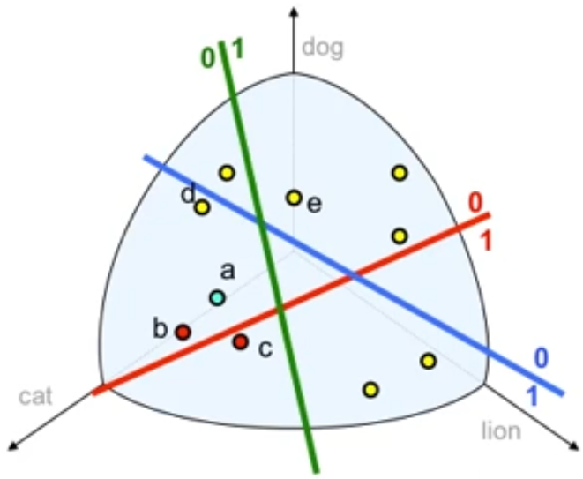
Improvements
Pandas → PySpark (challenge)
All-to-all → LSH
Multi stage → Single model

